Slide 1
Detecting Financial Frauds using Quantum Machine Learning
Made by -
Aaditya Kulkarni
2021A7PS0426P

Slide 2
Quantum Machine Learning
Quantum Machine Learning (QML) is a cutting-edge interdisciplinary field that unites the principles of quantum computing with machine learning algorithms. By leveraging the unique properties of quantum bits (qubits), such as superposition and entanglement, QML aims to enhance computational capabilities, enabling the processing of complex data patterns and relationships more efficiently than classical approaches. Quantum circuits, quantum algorithms, and innovative techniques like quantum support vector machines characterize this emerging field, offering the potential for breakthroughs in solving computationally intensive problems and advancing the frontier of artificial intelligence.

Slide 3
Classical ML vs Quantum ML
Classical ML
Quantum ML
Uses classical bits for data representation and computation.
Processes data iteratively and sequentially.
Algorithms based on classical optimization techniques.
Limited by polynomial time complexity for certain problems.
Utilises classical logic gates for logical operations.
Well established and mature with numerous available tools.
Leverages quantum bits for enhanced information processing.
Exploits quantum parallelism to perform parallel computation.
Utilises quantum algorithms that harness quantum principles.
Potentially exponential speedup in solving certain problems.
Uses quantum gates for complex entangled and superposed states.
Evolving field with ongoing research and development of quantum tools.

Slide 4
Problem statement
Financial fraud detection is a critical challenge in the banking and credit card industries. The aim of this project is to develop an advanced fraud detection system using Quantum Machine Learning (QML) techniques. The dataset provided consists of credit card transactions, each labeled as either fraudulent (Class 1) or non-fraudulent (Class 0). With a total of 284,807 transactions and a highly imbalanced class distribution, the primary objective is to train a robust model capable of accurately identifying fraudulent activities.

Slide 5
Key Objectives
Quantum Machine Learning Model: Implement quantum algorithms to train a machine learning model capable of handling the inherent complexity of financial datasets.
Class Imbalance: Address the issue of class imbalance in the dataset, where fraudulent transactions represent a small percentage. Explore quantum solutions to mitigate the impact of imbalanced data.
Feature Exploration: Investigate the impact of various features, including time, anonymous numerical values (v1 to v28), and transaction amount, on the model's performance.
Evaluation Metrics: Employ standard metrics such as accuracy, precision, recall, and F1 score to assess the model's effectiveness in fraud detection.

Slide 6
Dataset overview
Size: 284,807 transactions
Features: Time, anonymous numerical values (v1 to v28), transaction amount
Labels: Class 0 (non-fraudulent) and Class 1 (fraudulent)
Class Imbalance: Class 0 (non-fraudulent) - 99.83%, Class 1 (fraudulent) - 0.17%

Slide 7
Approach
Classical SVM Foundation
Initial Model Construction.
Assessment of raw accuracy.
Class imbalance consideration
Addressing data imbalance.
Downsampling for accurate evaluation.
Quantum Leap
Gradual transition to quantum models.
Exploring quantum circuits for enhanced representations.
Performance metrics
Consistent evaluation across classical and quantum models.
Uncovering synergies for Comprehensive fraud detection.
Holistic Insights
Understanding model strengths and limitations.
Unveiling a comprehensive perspective.

Slide 8
Classical SVM
1. Initial Approach:
- Implement Classical SVM Model.
-Unbiased Evaluation for Fraud Detection.
2. Unveiling High Accuracy:
- Initial Accuracy Assessment.
- Encountering Class Imbalance.
3. Class Imbalance Challenge:
- Identify and Acknowledge Imbalance.
- Substantial Majority of Non-Fraudulent Transactions.
4. Downsampling Strategy:
- Tackling Class Imbalance.
- Ensuring a Balanced Training Set.

Slide 9
Classical SVM
5. Impact on Accuracy:
- Post downsampling evaluation.
-Retaining high accuracy.
6. Insights and considerations:
- Balancing Acts : Tradeoff and benefits.
-Laying the groundwork for quantum advancements.
7. Visual Representation:
- Graphical representation of accuracy shift.
- Comparative analysis.
8. Key takeaways:
- Strategic downsampling for insightful evaluations.
- Establishing baseline for Quantum Model advancements.
(Detailed code explanation of every model in report)

Slide 10
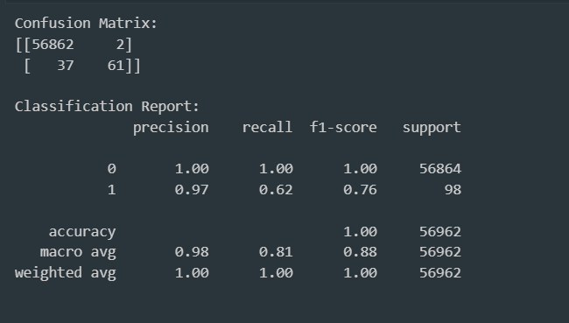
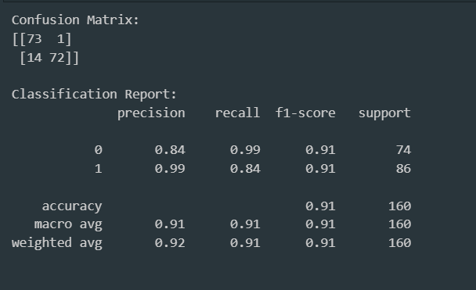
Evaluation metrics
Before class balancing
After class balancing
Accuracy : 99.3% F1-score : 76% (a better evaluation metric)
Accuracy : 91% F1-score : 91%

Slide 11
Quantum ML models
A total of 6 quantum ML models have been built.
The first model is based on training data on a basic quantum circuit.
The second model is based on training data on strongly entangling layers, which is a feature of Pennylane.
The third model is a QSVM, which used quantum feature mapping using a quantum circuit.
The fourth model is a QSVM, which used quantum feature mapping using strongly entangling layers.
The fifth model is a QSVM model made in Qiskit.
The sixth model (in progress) is a QVAE (Quantum Variational Autoencoder)

Slide 12
Model 1
Quantum Circuit Based Pennylane model
1. Dataset Preprocessing:
- Loading credit card dataset.
- Feature extraction and class labels.
2. Data Splitting and Standardization:
- Division into training and testing sets.
- Feature scaling using StandardScaler.
3. Quantum Circuit Definition:
- Quantum Node with 2 qubits (default.qubit).
- Parameterized Quantum Circuit (PQC).
4. Quantum Circuit Structure:
- Utilizing RY gates for parameterized rotations.
- CNOT gate for entanglement.
- Measurement via PauliZ.

Slide 13
5. Circuit Visualization:
- Visualizing Quantum Circuit with qml.draw.
- Sequential layout of gates on qubits.
6. QML Model and Cost Function:
- Defining QML model using PQC.
- Cost function as Mean Squared Error (MSE).
7. Model Training:
- Adam Optimizer for parameter updates.
- Iterative training for specified epochs.
8. Evaluation Metrics:
- Accuracy, Precision, Recall, F1 Score.
- Confusion Matrix for Detailed Analysis.
9. Optimization Iterations:
- Iterative parameter updates for 10 epochs.
- Adaptive learning using Adam Optimizer.

Slide 14
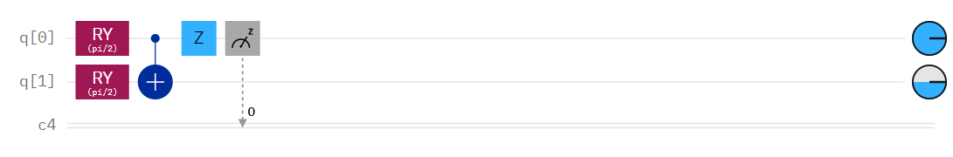
10. Performance Evaluation:
- Applicability to Credit Card Fraud Detection.
- Providing Comprehensive Model Metrics.
11. Model Utility and Interpretation:
- Utilizing Quantum Features for Prediction.
- Comparing Quantum and Classical Model Metrics.

Slide 15
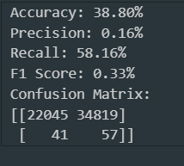
Results
Pretty less accuracy and F1-score was obtained.
Reasons for low accuracy and F1-score might be:
Class imbalance
A very basic quantum circuit

Slide 16
Model 2
QML model using Strongly Entangling Layers
1. Data Preprocessing:
The credit card fraud dataset ('creditcard.csv') is divided into two subsets: `data1` (Class 1 - fraudulent transactions) and `data0` (800 randomly sampled instances of Class 0 - non-fraudulent transactions). These subsets are combined, and the resulting dataset is shuffled.
2. Feature Extraction and Standardization
- Features (columns v1 to v28) and labels (Class) are extracted from the dataset.
- Features are standardized using `StandardScaler`.
- Principal Component Analysis (PCA) is applied to reduce the dimensionality to 2 components.
3. Data Splitting:
- The dataset is split into training and testing sets.
4. Quantum Circuit Definition:
- A quantum device with two qubits is defined using PennyLane's `lightning.qubit` simulator.
- The quantum circuit is defined using the `circuit` function, employing strongly entangling layers from PennyLane's template.

Slide 17
5. Cost Function and Optimization:
- The cost function is defined to calculate the mean squared error between the quantum circuit predictions and the true labels.
- Parameters are randomly initialized, and the circuit parameters are optimized using grading descent.
6. Prediction and Evaluation:
- Predictions are made on the test set by applying the quantum circuit.
- Classification accuracy and F1 score are calculated and printed.

Slide 18
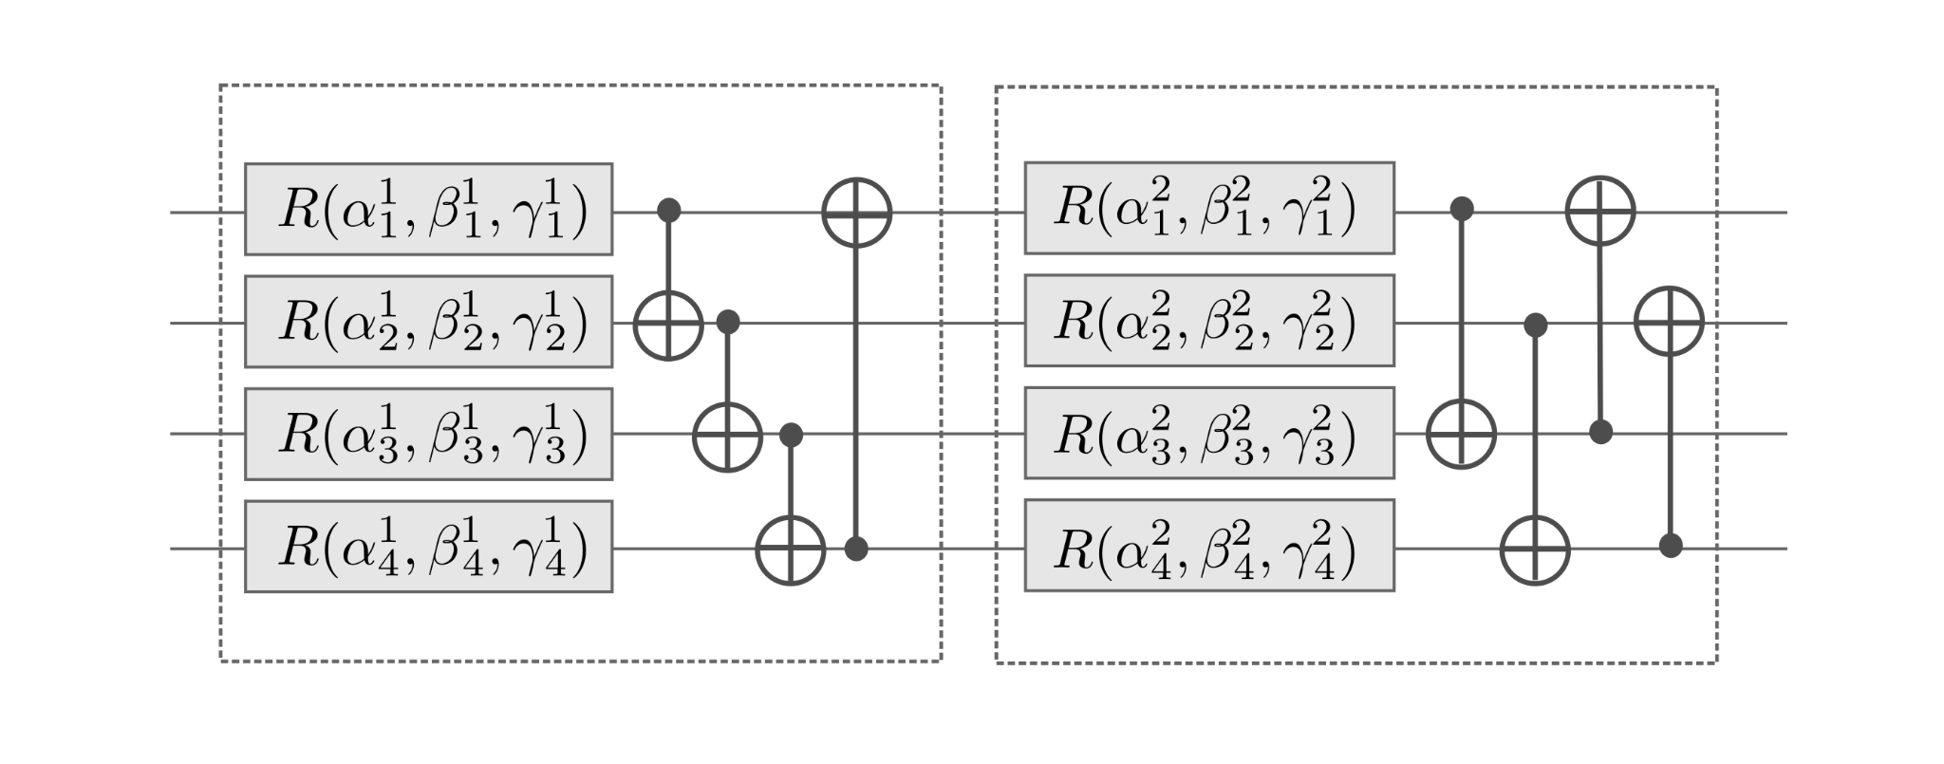
Strongly Entangling Layers Example (4 qubits)

Slide 19
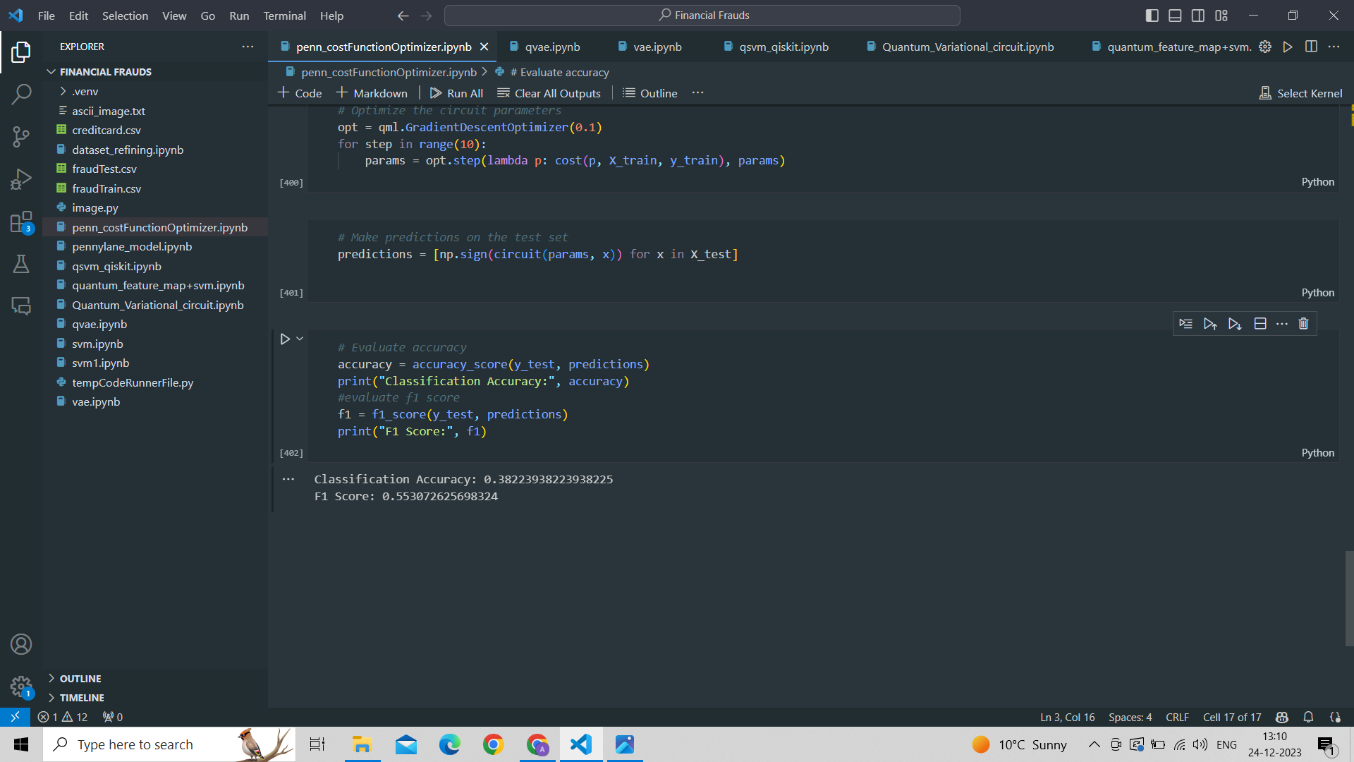
Results
Accuracy : 38.22%
F1 Score : 55.31%

Slide 20
Model 3
Quantum SVM model using Quantum circuits
1. Data Preprocessing:
-The dataset is balanced to address class imbalances, ensuring a representative mix of fraudulent and non-fraudulent transactions.
2. Feature Extraction and Standardization:
-Features and labels are extracted from the balanced dataset.
-The dataset is split into training and testing sets, and feature scaling is applied using StandardScaler.
3. Quantum Feature Map Optimization:
-A quantum circuit (quantum_circuit) is defined, incorporating Hadamard gates, rotation gates, CNOT gates, and RY gates.
-Quantum circuit parameters are initialized randomly.
4. SVM Integration:
-The quantum-transformed dataset integrates into a classical SVM framework with a precomputed kernel.
-The SVM is trained on the precomputed kernel matrix and used for predictions on the testing data.

Slide 21
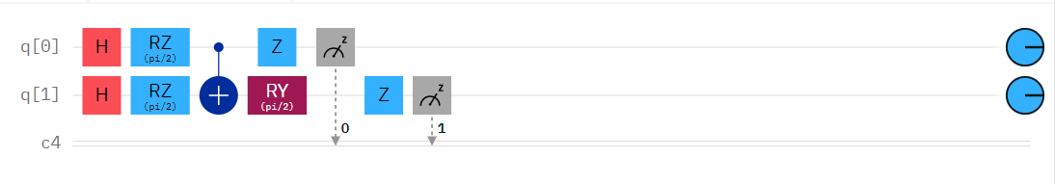
5. Model Evaluation:
Classification accuracy and F1 score are computed and printed, providing a comprehensive assessment of the model's performance in credit card fraud detection.
This advanced QSVM model represents a concerted effort to optimize the quantum feature mapping process, augmenting the model's ability to discern patterns indicative of fraudulent transactions. The robust evaluation metrics serve as a testament to the model's efficacy in enhancing fraud detection capabilities.
Gate representation

Slide 22
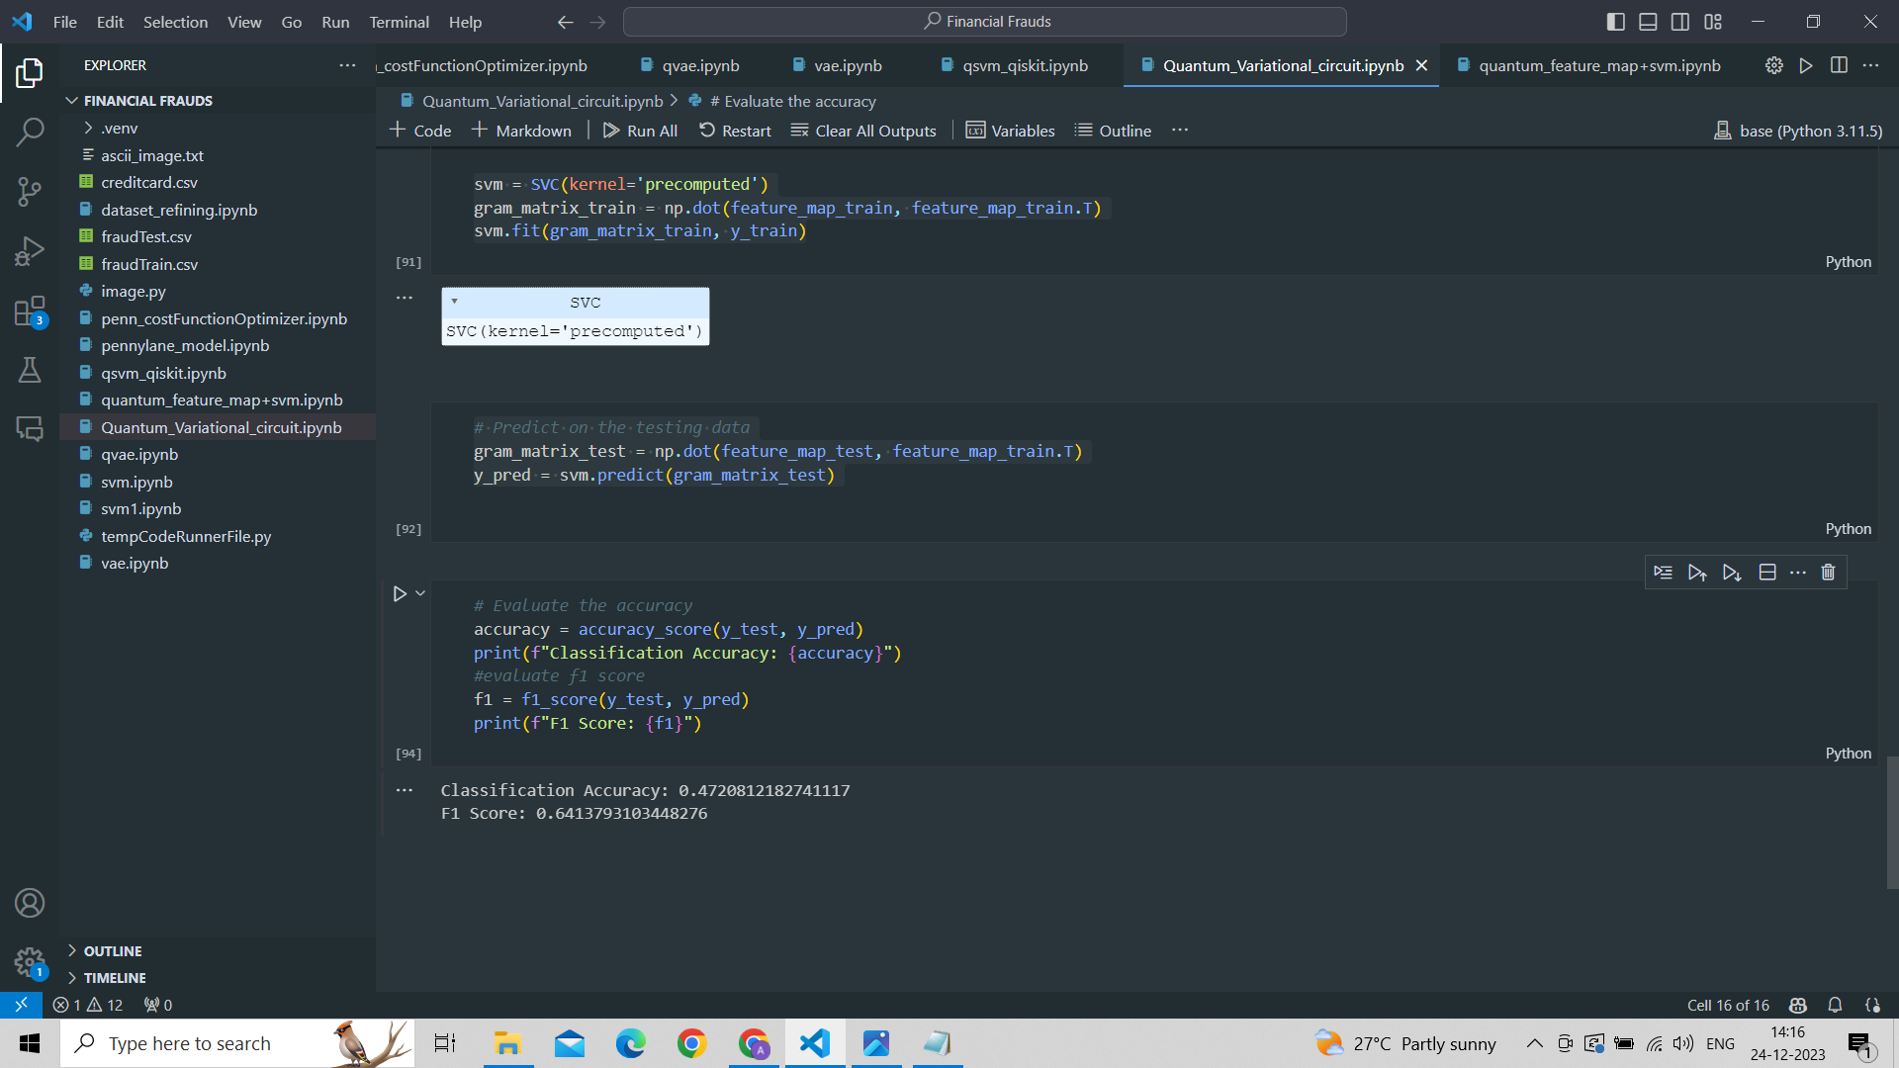
Results
Accuracy : 47.20%
F1 Score : 64.13%

Slide 23
MODEL 4
Quantum SVM using Strongly Entangling Layers
1. Data Loading and Preprocessing:
- The credit card dataset is loaded.
- Class 0 data is sampled to create a balanced dataset along with all Class 1 data.
- The dataset is shuffled for randomness.
2. Feature Extraction and Reduction:
- Features and labels are extracted from the dataset.
- Standardization is applied to the features.
- Principal Component Analysis (PCA) is utilized to reduce the features to two dimensions.
3. Data Splitting
- The preprocessed dataset is split into training and testing datasets with 80-20 ratio.
4. Quantum Feature Map Definition
- A quantum feature map is defined using Pennylane’s ‘Strongly Entangling Layers’
- It is designed to transform classical data into quantum features.

Slide 24
5. Quantum Feature Map Application:
- Quantum circuit parameters are initialized randomly.
- Quantum feature maps are applied to both the training and testing data.
- This quantum transformation introduces quantum-inspired features to classical data.
6. Classical SVM Training:
- A classical Support Vector Machine (SVM) is trained on the quantum features.
- The `SVC` (Support Vector Classification) from scikit-learn is employed for this purpose.
7. Prediction and Evaluation:
- Predictions are made on the testing data using the trained QFM-SVM model.
- The accuracy of the model is evaluated using classical machine learning metrics.
- The classical SVM is applied to quantum features, showcasing a hybrid approach for classification tasks.

Slide 25
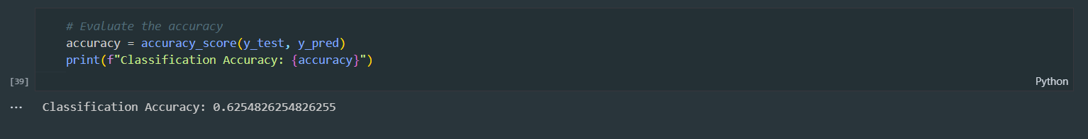
Results
Classification Accuracy = 62.54%

Slide 26
MODEL 5
QSVM model using Qiskit
1. Data Preparation:
- The credit card dataset is loaded and processed to ensure a balanced representation of both Class 0 and Class 1.
- 800 instances of Class 0 and all instances of Class 1 are combined, creating a comprehensive dataset.
- The dataset is randomly shuffled for optimal training conditions.
2. Feature Extraction and Standardization:
- Features and labels are extracted from the dataset.
- Standard scaling is applied to standardize the features, ensuring consistent scales for optimal QSVC training.
3. Quantum Feature Map and Kernel Definition:
- The quantum feature map is defined using Qiskit's ZZ FeatureMap, configured with two repetitions and linear entanglement.
- Fidelity Quantum Kernel is employed as the quantum kernel, leveraging the fidelity metric to quantify the similarity between quantum states.

Slide 27
4. QSVC Model Initialization:
- QSVC (Quantum Support Vector Classification) instance is created, incorporating the defined quantum feature map and kernel.
- The QSVC model is configured to operate on a quantum simulator (Aer backend) with specific shot configurations.
5. Model Training and Evaluation:
- QSVC is trained on the standardized training dataset.
- The model's performance is evaluated on the test dataset, and the classification test score is printed.
- Classification accuracy is calculated and printed to assess the model's efficacy.
6. Quantum Instance Configuration:
- The Aer backend with the qasm_simulator is chosen for quantum simulation.
- Quantum Instance is configured with specific shot parameters and random seeds for reproducibility.
7. Conclusion:
- The code showcases the implementation of a QSVC model using Qiskit, combining classical data preprocessing with quantum feature mapping and kernel techniques.
- The QSVC model's classification accuracy on the test dataset is reported, providing insights into its performance.

Slide 28
Results
The model's execution spanned over 10 hours and was ongoing, likely due to hardware-related challenges.

Slide 29
MODEL 6
QVAE model (still working on it)
1. Introduction to Q-VAE:
- Fusion of quantum computing and Variational Autoencoders (VAEs).
- Aims to harness quantum advantages for complex data tasks.
2. Classical VAE Overview:
- Common generative models for unsupervised learning.
- Comprises an encoder-decoder network minimizing reconstruction errors.
3. Quantum Extension:
- Q-VAE expands classical VAE into the quantum domain.
- Utilizes quantum circuits and gates for encoding and decoding.
- Leverages quantum states with superposition and entanglement properties.
4. Implementation Challenges:
- Intricate tasks involving quantum circuit understanding.
- Variational optimization and managing classical-quantum interactions.
- Quantum advantage context-dependent; challenges like quantum noise.

Slide 30
5. Q-VAE Development:
- Model development underway but incomplete due to inherent complexity.
- Eager to engage in further research for refinement and enhancement.
6. Conclusion:
- Quantum Variational Autoencoders present unique challenges and potential.
- Ongoing research and exploration for model improvement.

Slide 31
Conclusion
In conclusion, our exploration of Quantum Machine Learning (QML) has traversed the captivating intersection of quantum computing and machine learning, unveiling unique capabilities and challenges. We established a foundational understanding of quantum computing, delving into quantum circuits, cost functions, and entangling layers. Our focus on detecting financial frauds led us through classical and quantum SVM models, showcasing the robustness of classical SVMs even in the quantum realm. Quantum Variational Autoencoder (QVAE) models, while complex and incomplete, highlight the potential of quantum-enhanced generative models. The synergy between classical and quantum approaches reveals a promising frontier, indicating substantial potential for future research and innovation in Quantum Machine Learning. The tapestry of possibilities in this dynamic landscape invites continued exploration and discovery.

Slide 32
References
https://pennylane.ai/qml/
https://docs.pennylane.ai/en/stable/code/qml.html
https://docs.pennylane.ai/en/stable/code/api/pennylane.S.html
https://qiskit.org/documentation/locale/bn_BN/index.html
https://www.kaggle.com/datasets/mlg-ulb/creditcardfraud
https://arxiv.org/abs/1802.05779
https://qiskit.org/ecosystem/machine-learning/tutorials/12_quantum_autoencoder.html
https://par.nsf.gov/servlets/purl/10351398
https://iopscience.iop.org/article/10.1088/2058-9565/aada1f/pdf
https://qiskit.org/documentation/stable/0.24/tutorials/machine_learning/01_qsvm_classification.html
https://medium.com/mit-6-s089-intro-to-quantum-computing/quantum-support-vector-machine-qsvm-134eff6c9d3b
https://github.com/PatrickHuembeli/QSVM-Introduction/blob/master/Quantum%20Support%20Vector%20Machines.ipynb

